Slide 1
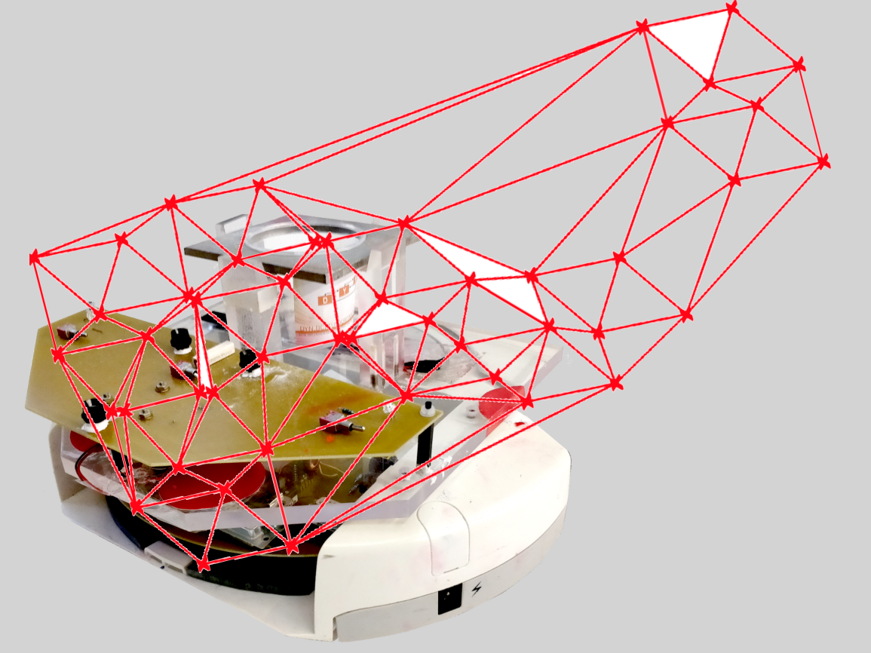
Project group SS18
Development of local positioning system for a pipe-less plant

Slide 2
Today
System overview – what is the pipe-less plant?
Project overview – what are you doing here?
Course formalities and goals
Initial tasks and plan for upcoming meetings
Visit the plant

Slide 3
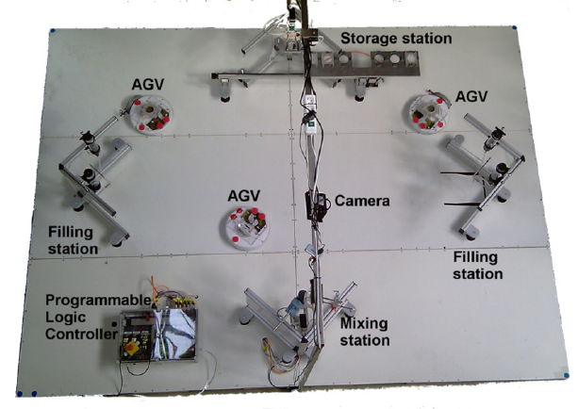
Pipeless plant

Slide 4
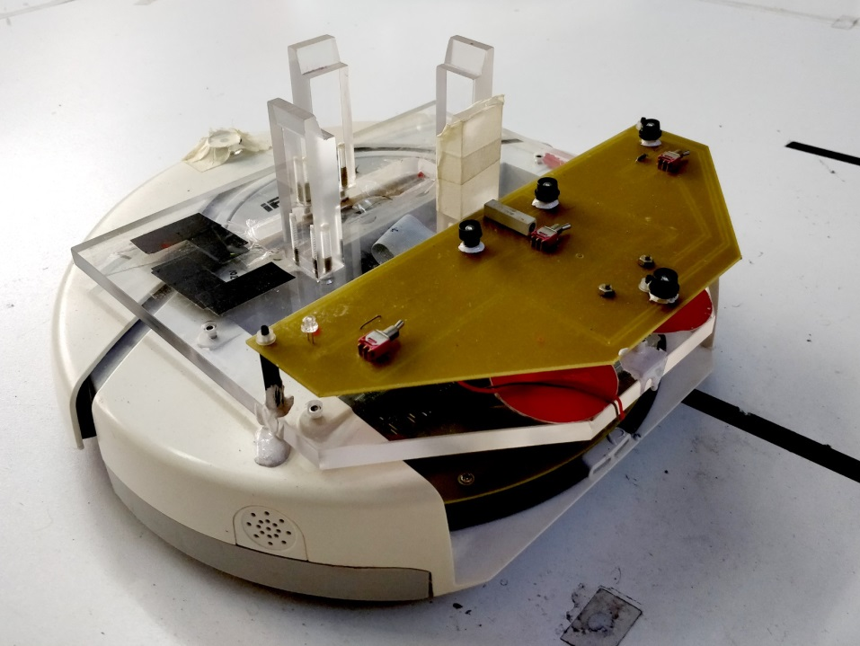
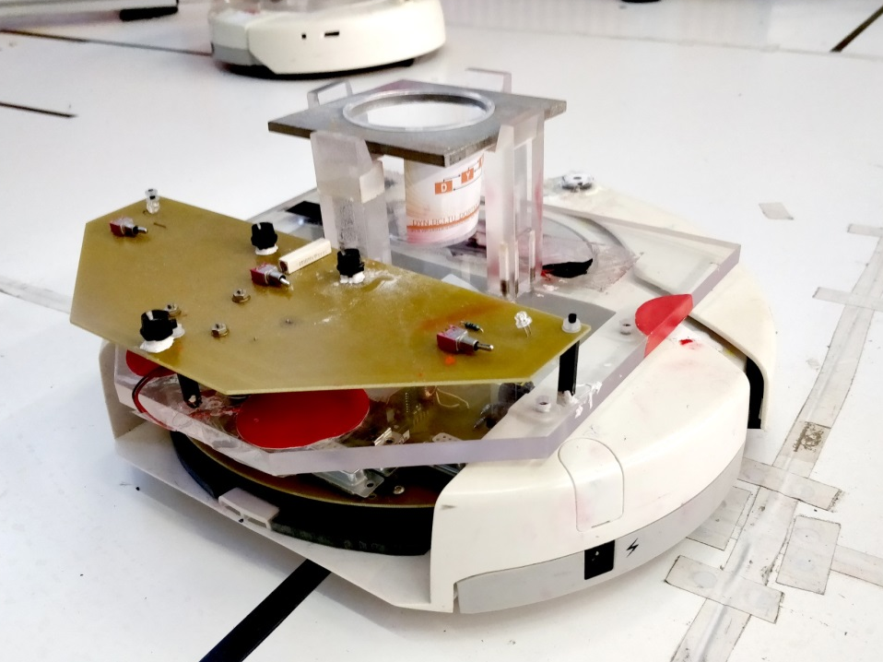
Current system

Slide 5
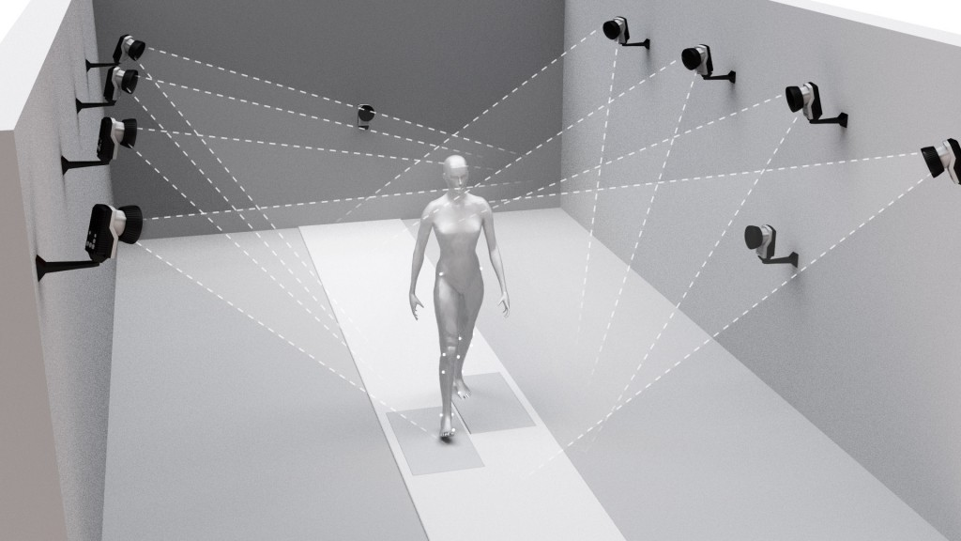
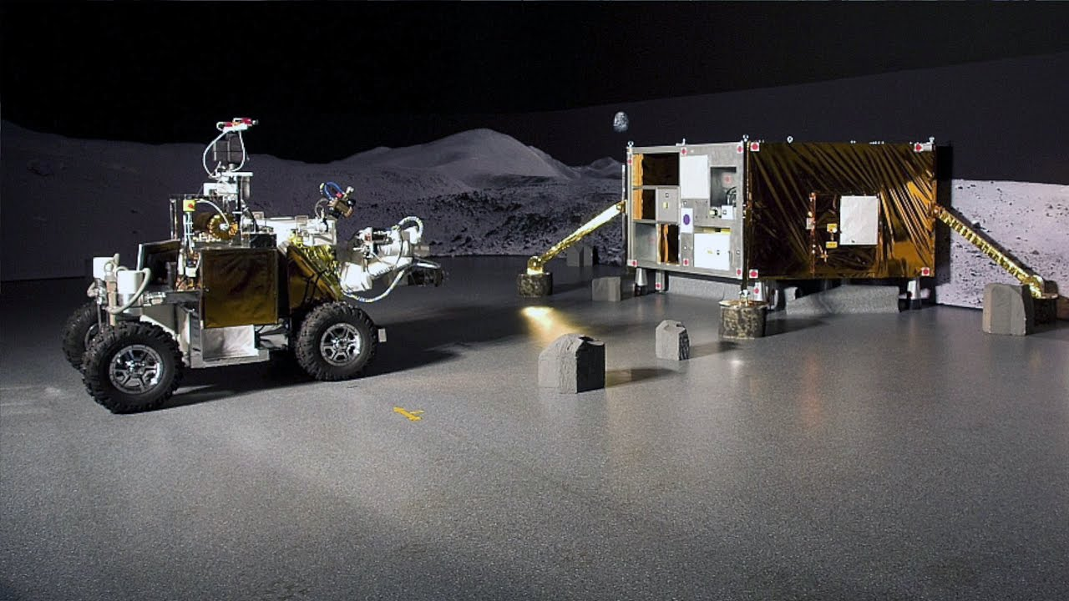
Local positioning systems

Slide 6
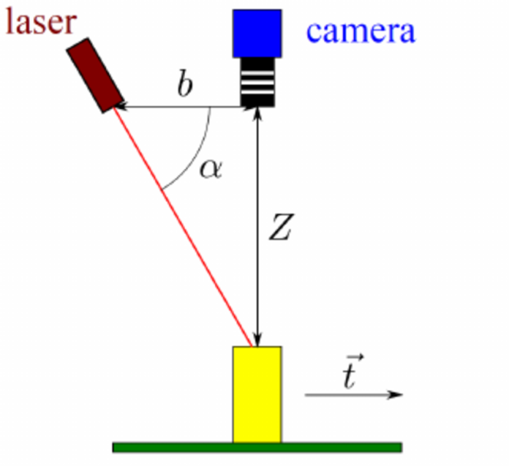
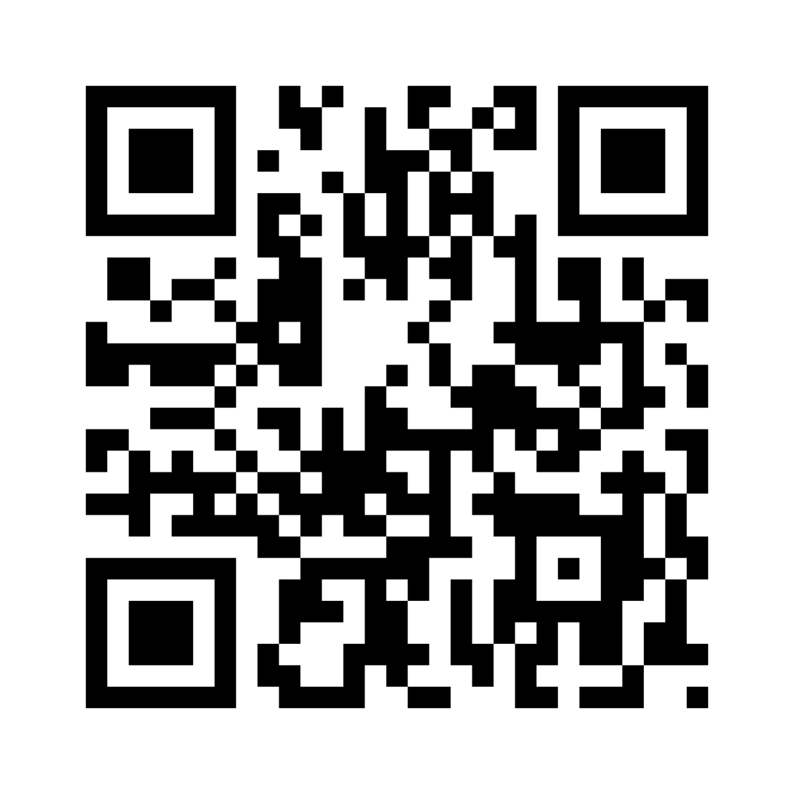
Project: Local positioning system
Pick alternative positioning system
Tringulation
Another pattern based systems
…
Evaluate, compare and develop proof-of-concept
Ultimate goal: improve positioning precision

Slide 7
Course structure
Start: today!
Duration: 12 weeks
End: preliminarily mid June
Examination:
Project contents and possible demonstrator of system
Weekly progress presentations
Final Presentation (co-located with other PGs)
Project Report

Slide 8
Learning goals
Understand positioning systems of robotic setups
Real life vs theory
Project management
How to run an open-ended project
Improve presentation skills

Slide 9
Until next time
Preliminary project plan including sub tasks and milestones
Select project leader
Familiarize with the pipe-less plant

